Slide 1

Cardiologist-level arrhythmia detection and classification in ambulatory electrocardiograms using a deep neural network
By: Rahul Awale, Rajendra Naidu Mannam, Sandeep Joshi, Jiawen Wei, Li Wang, Zengxin Qin

Slide 2
Introduction
DNN to diagnose irregular hearth rhythms
A Collaboration between Stanford ML and iRhythm Technologies
Published in Nature Medicine on January 2019
Used single-lead ECG signals

Slide 3
What is ECG?
Stands for Electrocardiogram
Checks for heart rhythms and electrical activity
300 millions ECG obtained annually
Can be used to detect arrhythmias

Slide 4
What is this study about?
Can DNN be used to analyze raw ECG data to classify broad range of diagnosis?
Good approach to take advantage of widespread digitization of ECG data
Developed a Deep Neural Network to classify 12 rhythm cases
Compared Performance to Cardiologists in an independent dataset

Slide 5
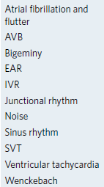
Training Data
Training data
91,232 ECG records
53,549 patients
12 rhythm classes
10 arrythmias
Sinus Rhythm
Noise

Slide 6
Training Data
Data was recorded using Zio Monitor
Mean wear time = 10.6 days
Median wear time = 13 days
Demographics for Test Data:
Mean Age- 69± 16 years
43% were women

Slide 7
Test Data
Test Data:
328 ECG records
328 patients
Data Collected by consensus committee of expert cardiologists
Demographics for Test Data:
Mean Age= 70± 17 years
38% were women
Mean inter-annotator agreement= 72.8%

Slide 8
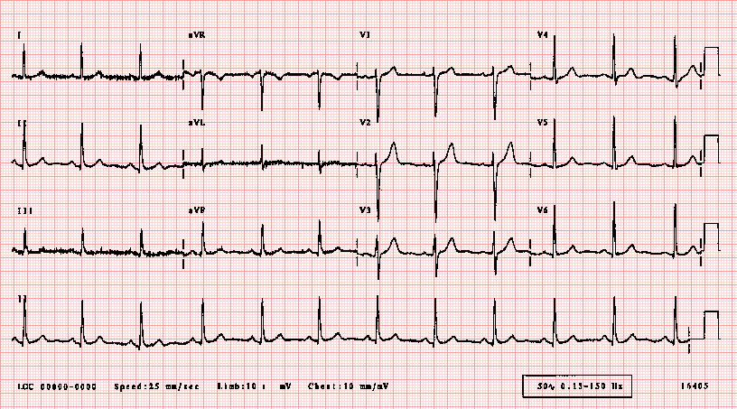
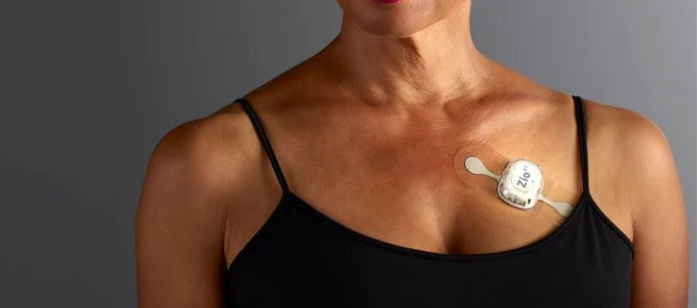
Model Design
convolutional deep neural network (34 layers)
Input: raw ECG data (200 Hz, or 200 samples per second)
Output: one prediction every 256 samples (output interval)

Slide 9
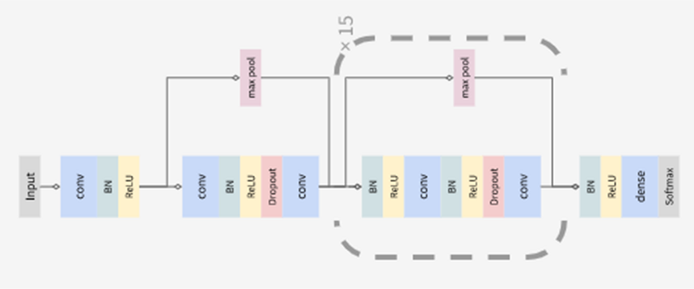
Model DESIGN
convolutional deep neural network (34 layers)​

Slide 10

Model DESIGN

Slide 11
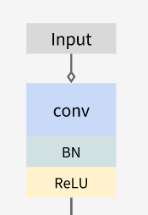
Model Design
Input
convolution – *batch normalization – ReLu
*Batch normalization (batch norm)
- a technique for improving the speed, performance, and stability
- normalize the input layer by re-centering and re-scaling
- solve *internal covariate shift:
- occurs when there is a change in the input distribution to our network.
- hidden layers try to learn to adapt to the new distribution, which slows down the training process.

Slide 12
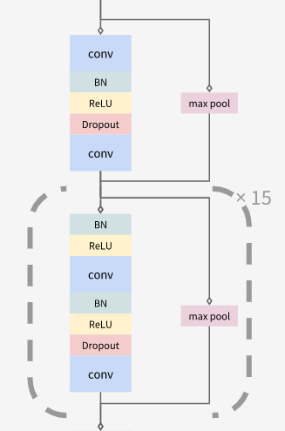
Model Design
- max pool - convolution – batch normalization – ReLu – dropout – max pool – convolution
- batch normalization – ReLu – max pool – convolution – batch normalization – ReLu – dropout – max pool – convolution x15

Slide 13
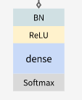
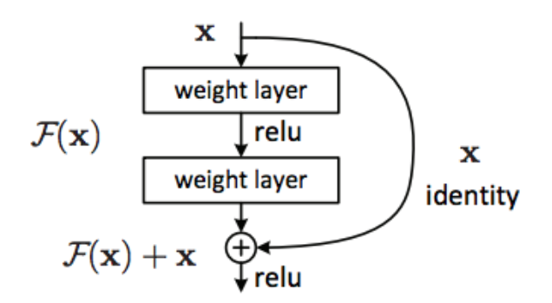
Model Design
- batch normalization – ReLu – full connection (dense) - output (softmax)
Employs shortcut connections in a manner similar to the *residual network architecture
*residual neural network (ResNet)
- add shortcuts that skip 2 or 3 layers. As we train, the model learns which layers are worth keeping and the ones that are not helping will be turned to identity mappings
- avoid the problem of *vanishing gradients
each of the neural network's weights receive an update proportional to the partial deravative of the error function with respect to the current weight in each iteration of training. The gradient will be vanishingly small, effectively preventing the weight from changing its value. In the worst case, this may completely stop the neural network from further training..
https://towardsdatascience.com/introduction-to-resnets-c0a830a288a4

Slide 14
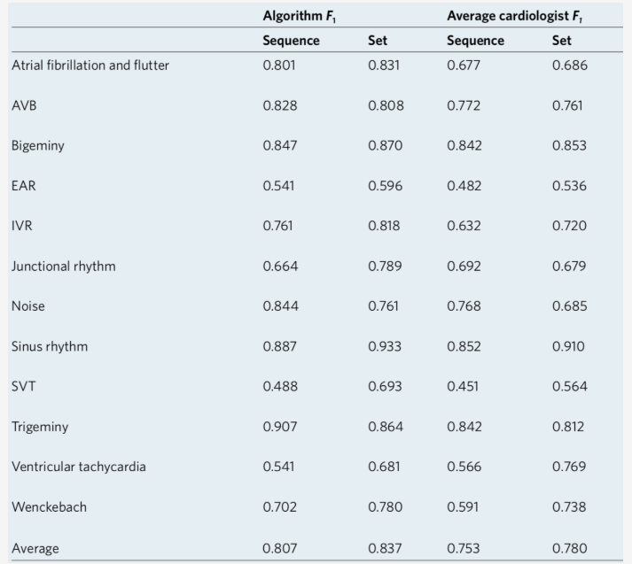
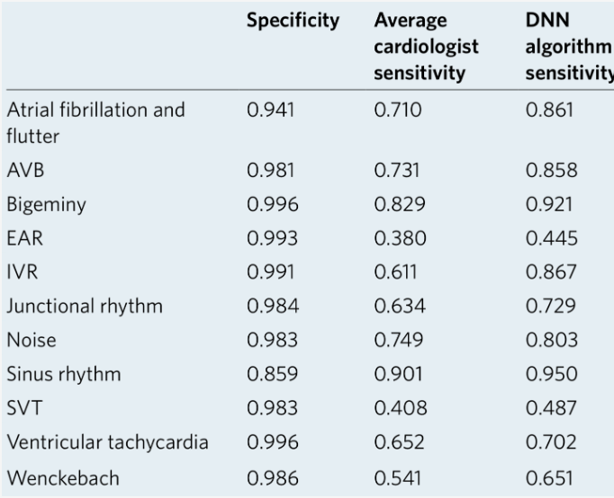
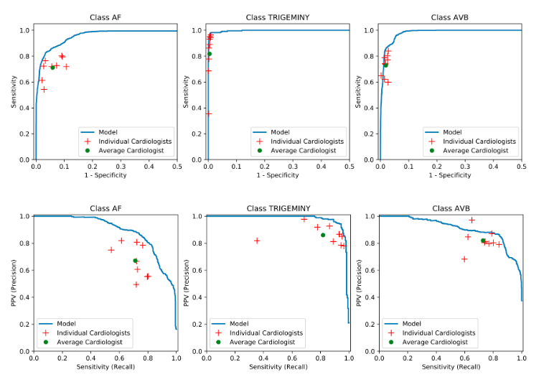
Model Execution
They compared the DNN algorithm F1 score to the average individual cardiologist F1 score, which is the harmonic mean of the positive predictive value (PPV; precision) and sensitivity (recall). Cardiologist F1 scores were averaged over six individual cardiologists
Their DNN had a higher average F1 scores than cardiologists. The trend of DNN F1 scores tended to follow that of the averaged cardiologist F1 scores: both had lower F1 on similar classes, such as ventricular tachycardia and ectopic atrial rhythm (EAR).
They plotted receiver operating characteristic curves (ROCs) and precision-recall curves for the sequence-level analyses of rhythms: a few examples are shown. Individual cardiologist performance and averaged cardiologist performance are plotted on the same figure

Slide 15
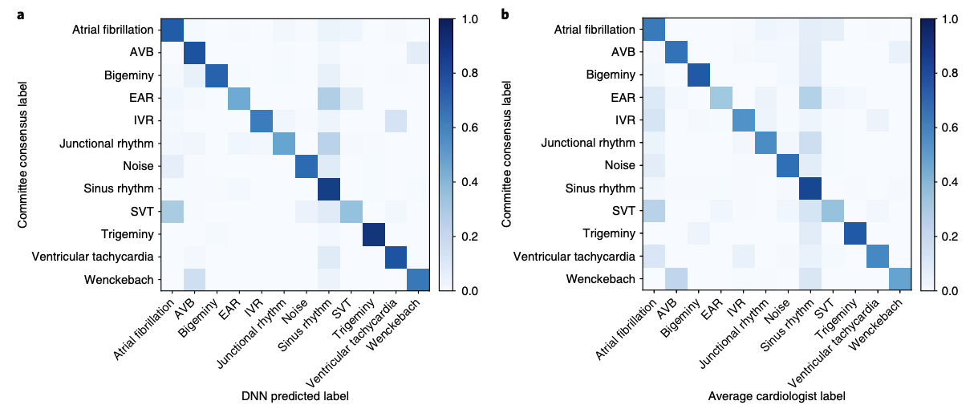
Predictions
Model made 23 predictions per 30 sec record and was evaluated at sequence level and set level⁺.
Over 12 rhythm classes, DNN achieved average class weighted AUC of 0.97, outperforming F₁* scores and senstivities of cardiologist. 0.837 vs 0.780.
Confusion matrix comparison:
Performs better for almost all true positive cases.
Shows similar patterns in misclassifications as Cardiologists.
Notes:
+ The set-level evaluation, unlike the sequence-level, does not penalize for time misalignment of a rhythm classification within a record.
*F1 Score is harmonic mean of the positive predictive value and sensitivity. Helpful in the setting of multi-class prediction and less sensitive than the AUC
Sequencies were anotated by Cardiologists to mark start-end of a record/heartbeat.
It ranges from 0 to 1 and rewards algorithms that maximize both PPV (positive predictive vaules) and sensitivity simultaneously
Accuracy was measure by comparing against committee consensus

Slide 16
CONCLUSION
They developed this convolutional DNN to detect arrhythmias. And this network architecture has 34 layers and only take raw ECG data as input.
Then they compared results from this DNN model and the performance from expert cardiologists. Apparently, their DNN had a higher average F1 score. Also, the sensitivity of the DNN exceeded the average cardiologist sensitivity for all rhythm classes section.
For all these results above, they're showing that the model met or exceeded the averaged cardiologist performance for all rhythm classes

Slide 17
CONCLUSION
After they validate the DNN with an external data from a different patient population, it shows this model performed competitively. We believe it is a successful design and can bring real values in clinical medicine or health care.
These findings demonstrate that an end-to-end deep learning approach can classify a broad range of distinct arrhythmias from single-lead ECGs with high diagnostic performance similar to that of cardiologists. If confirmed in clinical settings, this approach could reduce the rate of misdiagnosed computerized ECG interpretations and improve the efficiency of expert human ECG interpretation by accurately triaging or prioritizing the most urgent conditions.

Slide 18
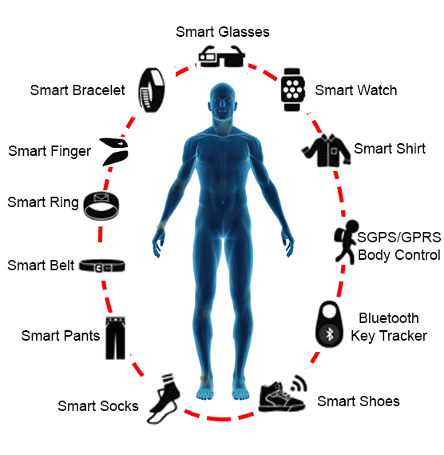
IN THE FUTURE
More and more wearable technology growing fast
More human data can be used in machine learning to diagnose or detect diseases
To improve bio-robot technology or bionics design in different industry
So many chances and possibility to improve our daily life

Slide 19
Reference:
Hannun, A.Y., Rajpurkar, P., Haghpanahi, M. et al. Cardiologist-level arrhythmia detection and classification in ambulatory electrocardiograms using a deep neural network. Nat Med 25, 65–69 (2019). https://doi.org/10.1038/s41591-018-0268-3

Slide 20
Questions?

